Slide 1
The ACCESS Team
2021-2022
Notes:
Type your information on each applicable slide. You may delete or rearrange any slide to make this work better for your needs.

Slide 2
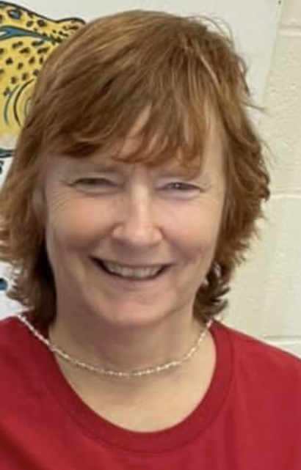
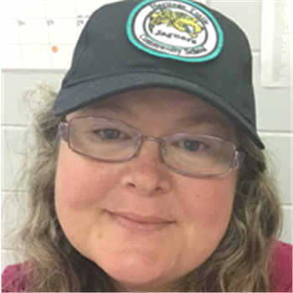
Staff
All of our staff look forward to working alongside each student as they progress toward their educational and personal goals this year.
Teachers this year are:
Mrs. Dove
&
Mrs. Rogers

Slide 3
Staff
Our wonderful team of Paraprofessionals this year are:
Mr. Bailey
Mr. Brown
Mrs. Edington
Mr. Elwell
Ms. Norton

Slide 4
Daily Schedule
^{Homeroom/1st: Social/Emotional}
^{2nd: Career}
^{3rd: Math}
^{4th: ELA (with Mrs. Dove)}
^{Lunch}
^{5th: Social Studies}
^{6th: Science}
^{7th: Learning Strategies}

Slide 5
PBIS
Our students use Trail Sheets to help them monitor their behavior and academics throughout the day.
Students participate in creating the academic and behavior goals for their individual Trail Sheets.
Along the Trail, students earn rewards.
If you would like to discuss your child's individual Trail Sheets, please contact us.
©Teaching with Little Winks

Slide 6
Curriculum
The District's ACCESS curriculum is provided through the Unique Learning System (ULS). This curriculum is individualized for each student's learning level and can be completed online or with printed materials.
Supplemental activities are provide through Math Prodigy, Vizzle, BrainPop, and various others online platforms and printed materials.

Slide 7
Grades
Students receive daily participation grades, which are averaged and entered into Focus twice per grading period.

Slide 8
Please email us with any questions.
Mrs. Rogers
rogersw@leonschools.net
Mrs. Dove
doveg@leonschools.net

